Slide 1

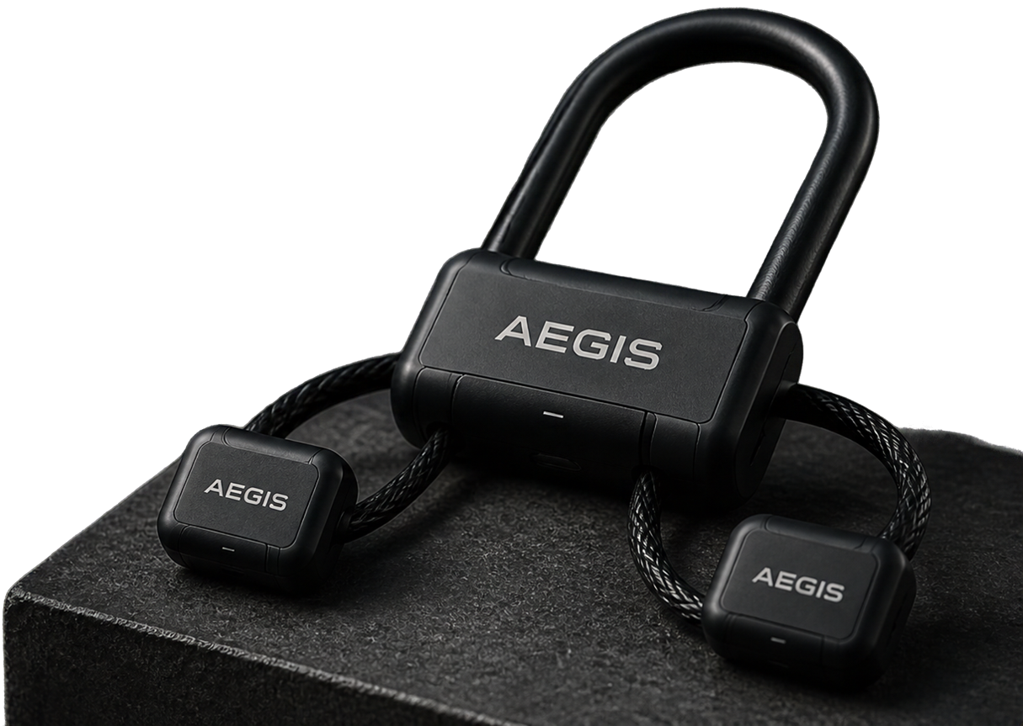
Aegis:
Distributed
Smart Bicycle Lock
Heavy-duty, open-source security with splitnode architecture
Team Aegis
2026-10-23

Slide 2

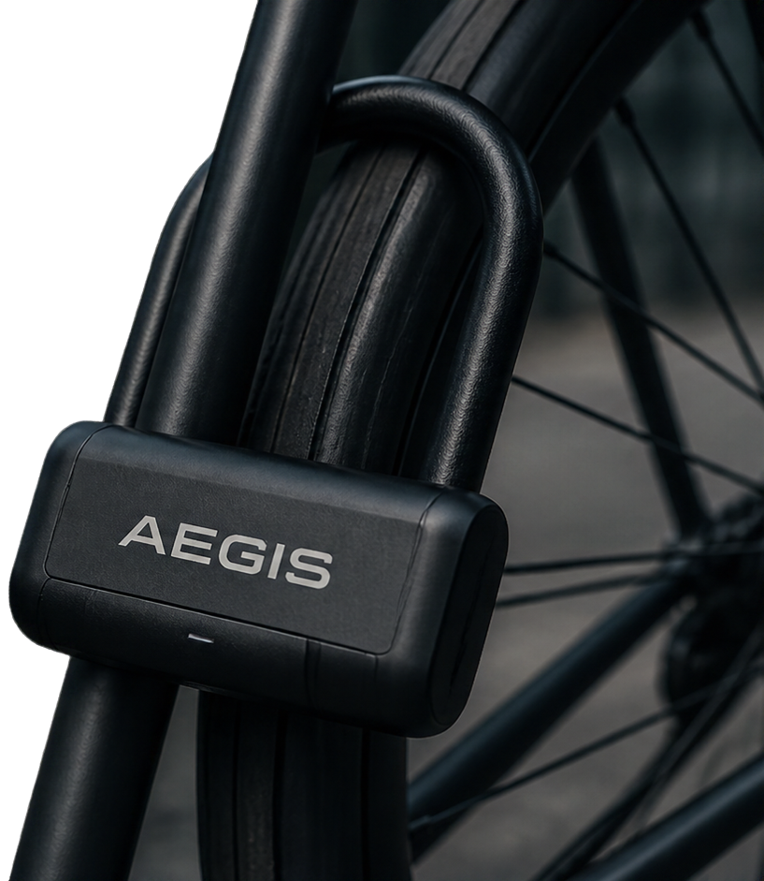

What is Aegis?
Heavy-duty, open-source smart lock for bicycles
Splitnode architecture separates interface and lock
Built to resist tampering
and brute-force attacks
Engineered for durability
in real-world conditions

Slide 3

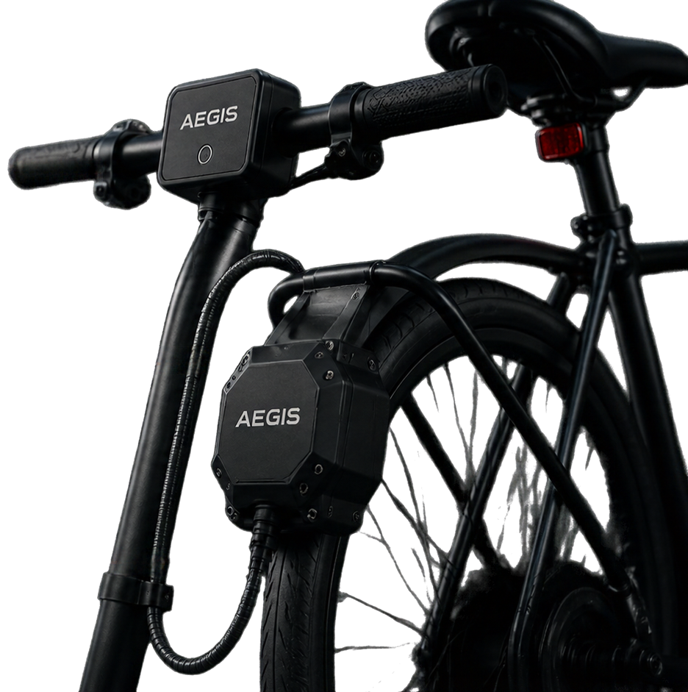

System Architecture
Handlebar Hub
User Interface
Arduino Nano with NFC card
reader and push button
Mounted on handlebars, IP65 rating
Armored Rear Hub
Brain & Locking Mechanism
ESP32 microcontroller controlling 12V worm-gear motor and alarm
Houses battery pack, accelerometer, and siren
Secure Connection
Weather-sealed Cat5e cable
forming a tamper-detecting Dead-Man Loop

Slide 4

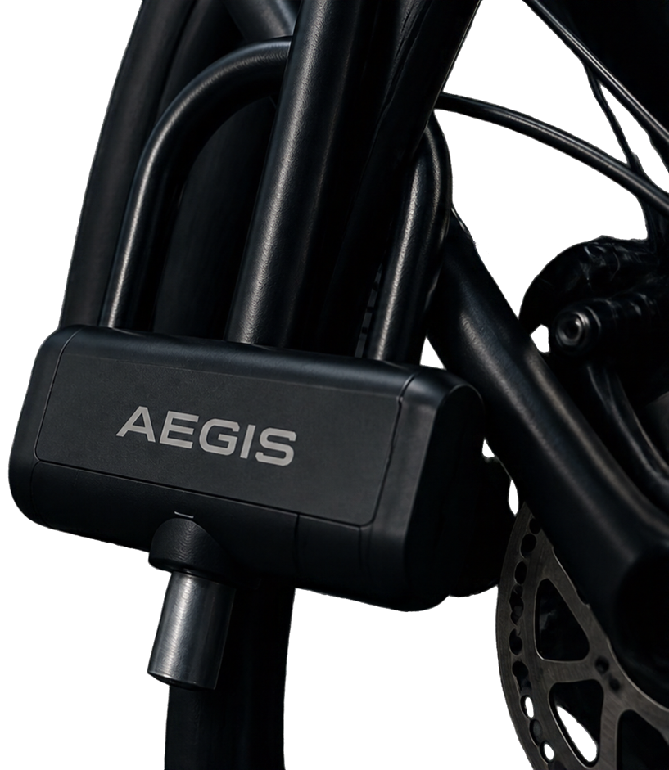
Tamper Resistance & Security Features
Continuity circuit detects enclosure breaches instantly
110dB alarm triggers on cutting or forced entry
Hardened steel deadbolt secures the rear wheel
Motion sensing wakes the system at the first sign of tampering
Split-node design keeps critical components out of reach

Slide 5

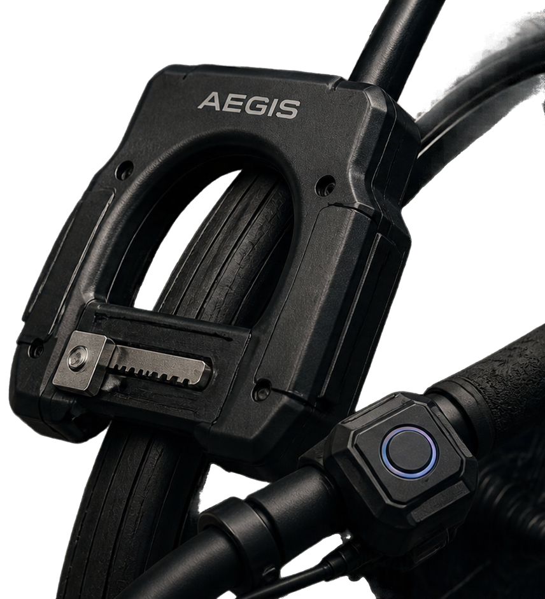
Hardware & Mechanical Design
Highlights
Armored rear hub
with heavy-duty horseshoe frame lock
JGY370 12V worm gear motor
driving rack and pinion deadbolt
Limit switches
prevent motor overrun and gear damage
Weatherproof enclosures
3D-printed in impact-resistant materials with gasket seals
Handlebar Hub
features waterproof push button
and RGB LED feedback

Slide 6

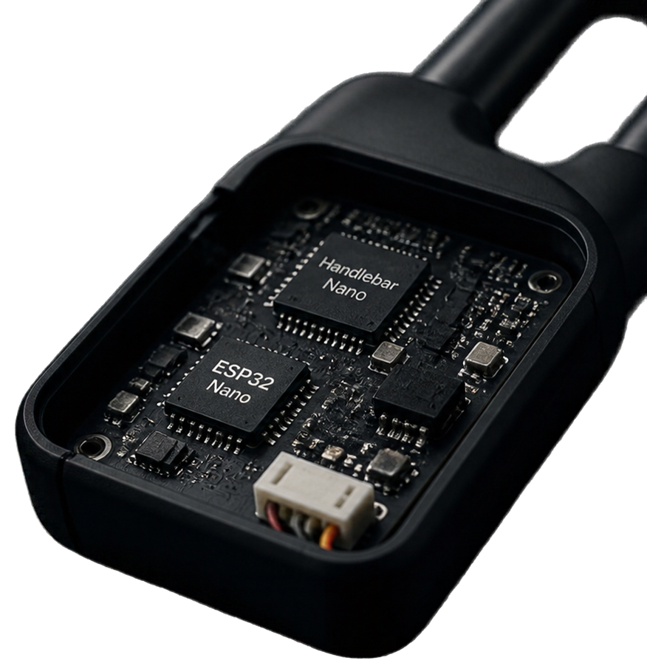
Firmware &
Power Management
NFC unlock via Handlebar Nano, commands sent over UART
Rear ESP32 manages the lock, alarm and system state
Deep sleep mode with ~10μA sleep current when locked
MPU6050 accelerometer wakes on tamper detection
Built for months of battery life
on a single charge

Slide 7

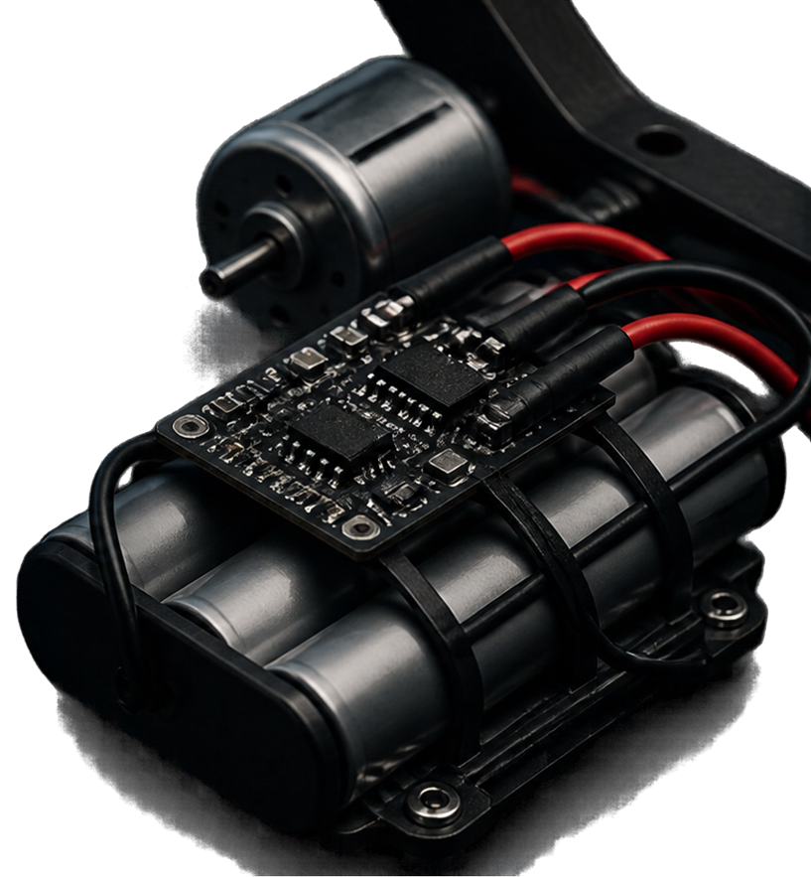
High-Current
Safety Considerations
12V motor can draw up to 2A stall current requires robust PCB routing (4.0mm trace width)
Use only protected 3S 18650 battery packs
with BMS charging IC
Avoid unbalanced or unprotected
battery configurations
Ensure proper wiring and mechanical
assembly to prevent shorts or overcurrent

Slide 8

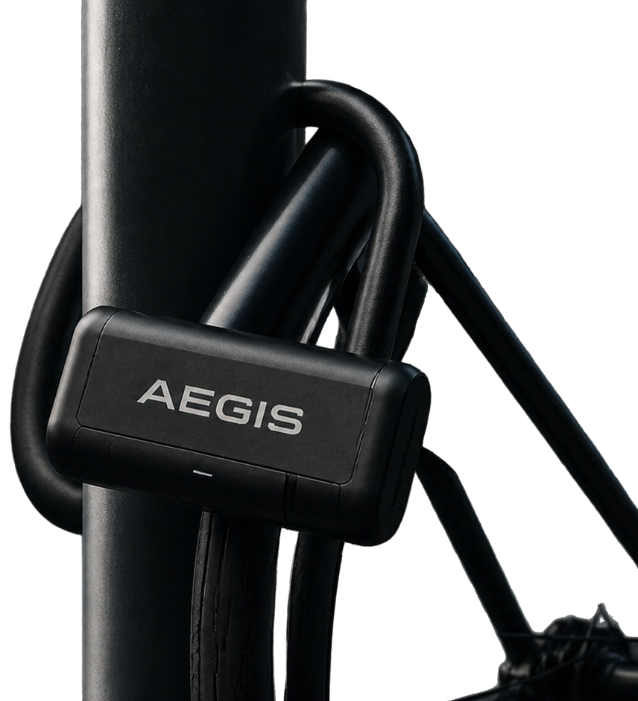
Thank You & Next Steps
Thanks for exploring Aegis
Manufacturing files and assembly instructions coming soon
Visit the project website for updates
Join the open-source community
or contribute to the project

